Slide 1
The Intersection of Antimicrobial-Resistant Tuberculosis and Social Vulnerabilities in Moldova: A Retrospective Analysis
Ben Jones
ILE: Epidemiology & Biostatistics

Slide 2

Background
MDR-TB is resistant to:
Rifampicin
Isoniazid
150,000 annual deaths globally
Standard TB treatment:
6 - 9 months
MDR-TB treatment:
24+ months
Social factors (i.e. homelessness) can influence risk of negative clinical outcomes
Image: Gheorghe Vrabie

Slide 3
Research Hypotheses + Aims
Hypothesis 1:
All types of drug-resistant TB are associated with higher odds of mortality compared to drug-susceptible TB.
Hypothesis 2:
All social vulnerabilities looked at are associated with higher odds of having some type of drug-resistant TB.
Aims:
Quantify the relationships between TB mortality, TB drug resistance, and social vulnerabilities.

Slide 4

Methodology: Data Inclusion
Source:
BUSPH Department of Epidemiology & Biostatistics
11,687 TB-positive patients in Moldova
Collected between 2008 - 2009
Inclusion in Analysis:
Confirmed TB test
Drug susceptibility testing results
Known treatment outcome
No missing variable data
Final Sample Size:
6,414 patients
Image: Hiranmay Baidya / Getty Images

Slide 5
Methodology: Statistical Approach
Mortality Model:
Binary logistic regression
Evaluate association between drug resistance type and TB mortality
Social Factors Model:
Multinomial logistic regression
Identify factors associated with different types of drug resistance
Covariates:
9 Social Factors including but not limited to:
Age at diagnosis
Sex
Occupation
Homelessness

Slide 6
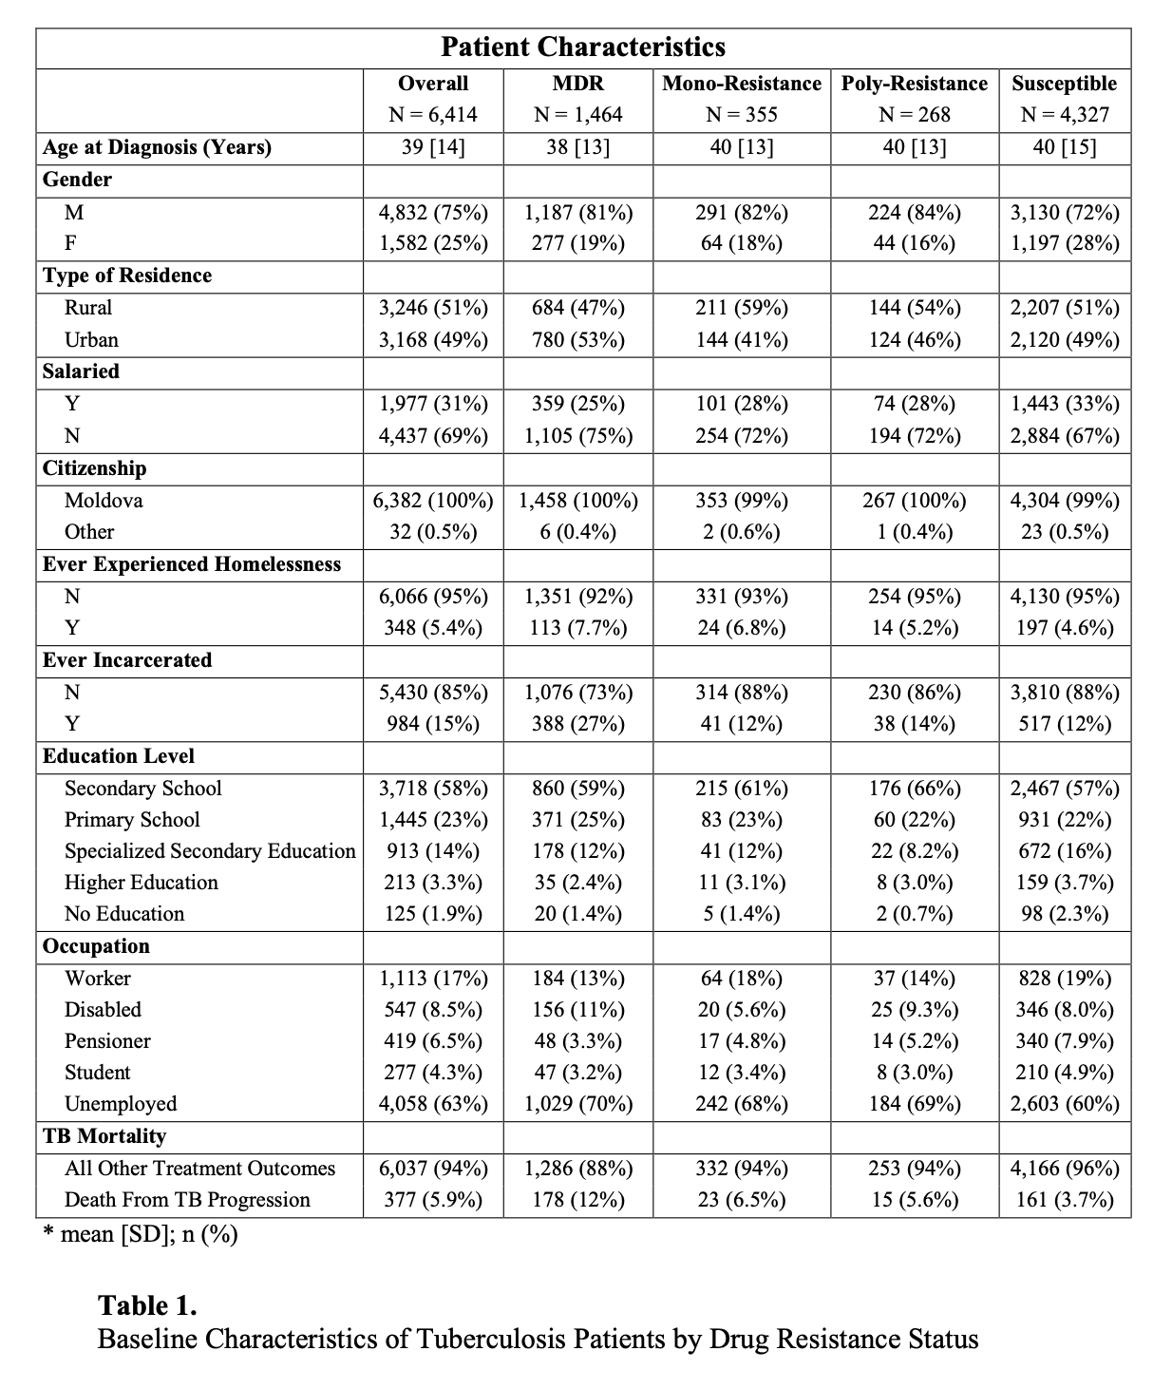
Descriptive Statistics of Sample Population

Slide 7
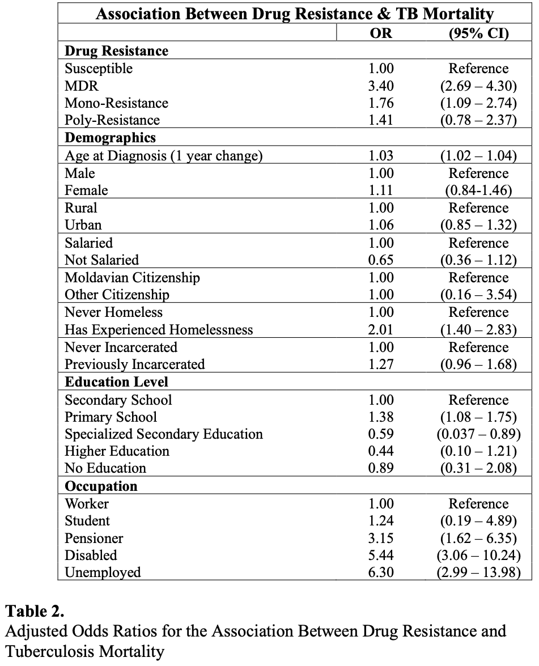
Results: Mortality Model
MDR-TB had 3.4 times the odds of mortality (compared to susceptible TB)
Unemployed had 6.3 times the odds of mortality (compared to workers)
Other major predictors are being on disability (OR: 5.44) and homelessness (OR: 2.01)

Slide 8
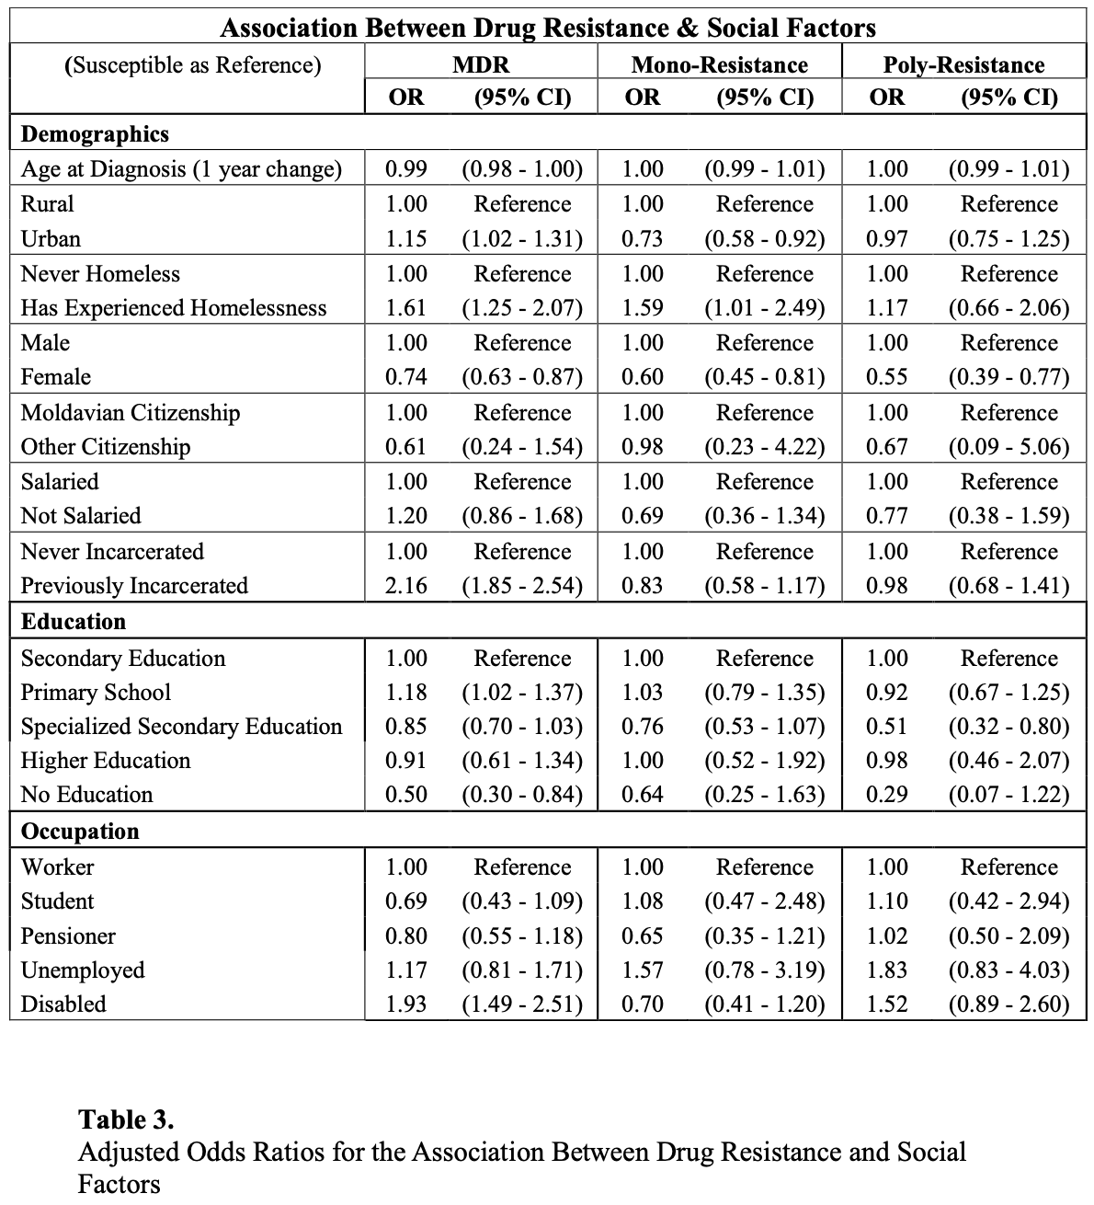
Results: Social Factors Model
Prior incarceration doubled odds of contracting MDR-TB
Females had 26% lower odds of contracting MDR-TB compared to males
No education associated with 50% lower odds of contracting MDR-TB compared to secondary education

Slide 9
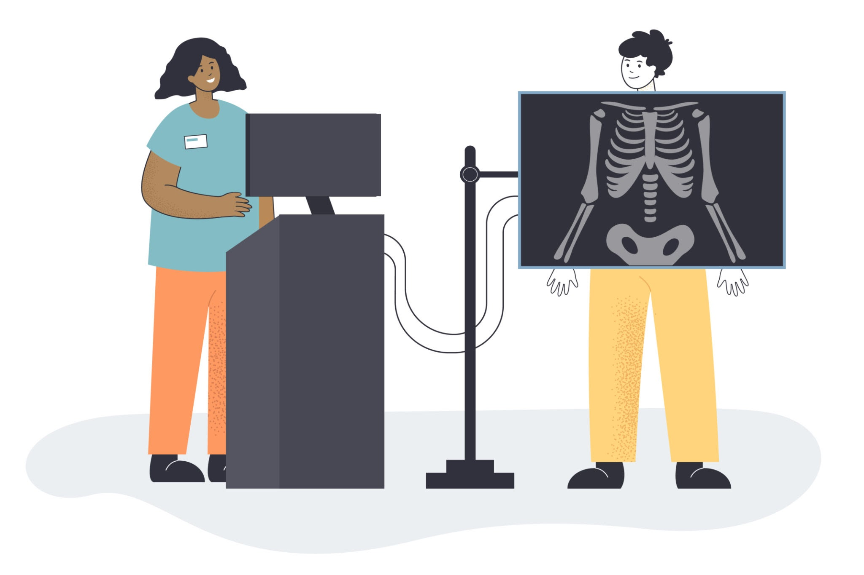
Discussion
Complexity of drug-resistant strains of TB can triple the mortality risk
High odds associated with unemployment and being on disability
Incarceration remains high-transmission environment for TB
Limitations:
Retrospective
2008 Financial Crisis
Image: BRO Vector / Getty Images

Slide 10
Conclusion
The intersection of drug-resistance and social vulnerability creates a crisis that pharmacology alone cannot solve.
Social realities are as impactful, if not more so, than the presence of MDR-TB itself regarding mortality.
Public health interventions must include soial protection programs and economic support to effectively control the disease.

